Slide 1
Chapter 9
Exception Handling
李晔锋

Slide 2
Key Skills & Concepts
Know the exception hierarchy
Use try and catch
Understand the effects of an uncaught exception
Use multiple catch statements
Catch subclass exceptions
Nest try blocks
Throw an exception
Know the members of Throwable
Use finally
Use throws
Know Java’s built-in exceptions
Create custom exception classes

Slide 3
Preface
An exception is an error that occurs at run time. Using Java’s exception handling subsystem you can handle run-time errors.

Slide 4
The Exception Hierarchy
In Java, all exceptions are represented by classes. All exception classes are derived from a class called Throwable. There are two direct subclasses of Throwable: Exception and Error.
Exceptions of type Error are related to errors that occur in the Java Virtual Machine itself, and not in your program.
Errors that result from program activity are represented by subclasses of Exception.

Slide 5
Exception Handling Fundamentals
Java exception handling is managed via five keywords: try, catch, throw, throws, and finally. They form an interrelated subsystem in which the use of one implies the use of another.

Slide 6
Using try and catch
At the core of exception handling are try and catch. These keywords work together; you can’t have a catch without a try. Here is the general form of the try/catch exception handling blocks:
try{
//block of code to monitor errors
}
catch(Exception1 exp){
//code to handle exception1
}
catch(Exception2 exp){
//code to handle exception2
}
…

Slide 7

A Simple Exception Example
public class ExcDemo1 {
public static void main(String[] args) {
// TODO Auto-generated method stub
int nums[] = new int[4];
try {
System.out.println("Before exception is generated");
nums[7] = 10;
}
catch(ArrayIndexOutOfBoundsException exc) {
System.out.println("Index out-of-bounds");
}
System.out.println("After catch statement");
}
}

Slide 8
Using try and catch
Note: if no exception is thrown by a try block, no catch statements will be executed and program control resumes after the catch statement.
Try: change nums[7] to nums[0].

Slide 9
Exception Generated by a Method
public class ExcDemo2 {
static void genException() {
int nums[] = new int[4];
System.out.println("Before exception is generated");
nums[7] = 10;
System.out.println("This won't be displayed");
}
public static void main(String[] args) {
// TODO Auto-generated method stub
try {
genException();
}
catch(ArrayIndexOutOfBoundsException exc) {
System.out.println("Index out-of-bounds");
}
System.out.println("After catch statement");
}
}

Slide 10
Using try and catch
Understand, however, that if genException( ) had caught the exception itself, it never would have been passed back to main( ).
Try: Add try…catch… statement in genException() function.
static void genException() {
int nums[] = new int[4];
try {
System.out.println("Before exception is generated");
nums[7] = 10;
}
catch(ArrayIndexOutOfBoundsException exc) {
System.out.println("Exception caught in method");
}
}

Slide 11
The Consequences of an Uncaught Exception
In general, if your program does not catch an exception, then it will be caught by the JVM. The trouble is that the JVM’s default exception handler terminates execution and displays a stack trace and error message.
Eclipse will display the exception information in red font in the console. You can click the link to direct you to the line of code where the exception occurs.

Slide 12

public class NotHandled {
public static void main(String[] args) {
// TODO Auto-generated method stub
int nums[] = new int[4];
System.out.println("Before exception is generated");
nums[7] = 10;
}
}

Slide 13
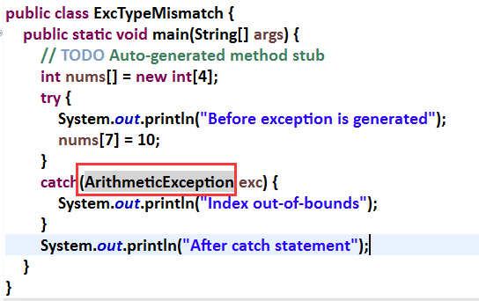
Exception Type Mismatch
As mentioned earlier, the type of the exception must match the type specified in a catch statement. If it doesn’t, the exception won’t be caught.

Slide 14
Exceptions Enable You to Handle Errors Gracefully
One of the key benefits of exception handling is that it enables your program to respond to an error and then continue running.

Slide 15
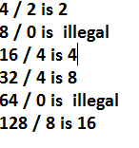
public class ExcDemo3 {
public static void main(String[] args) {
// TODO Auto-generated method stub
int numer[] = {4,8,16,32,64,128};
int denom[] = {2,0,4,4,0,8};
for(int i = 0; i < numer.length; i++) {
try {
System.out.println(numer[i] + " / " +
denom[i] + " is " +
numer[i] / denom[i]);
}
catch(ArithmeticException exc) {
System.out.println(numer[i] + " / " +
denom[i] + " is illegal");
}
}
}
}

Slide 16
Using Multiple catch Statements
As stated earlier, you can associate more than one catch statement with a try. In fact, it is common to do so. However, each catch must catch a different type of exception.

Slide 17
public class ExeDemo4 {
public static void main(String[] args) {
// TODO Auto-generated method stub
int numer[] = {4,8,16,32,64,128,256,512};
int denom[] = {2,0,4,4,0,8};
for(int i = 0; i < numer.length; i++) {
try {
System.out.println(numer[i] + " / " +
denom[i] + " is " +
numer[i] / denom[i]);
}
catch(ArithmeticException exc1) {
System.out.println(numer[i] + " / " +
denom[i] + " is illegal");
}
catch(ArrayIndexOutOfBoundsException exc2) {
System.out.println("No matching element found");
}
}
}
}

Slide 18
Catching Subclass Exceptions
There is one important point about multiple catch statements that relates to subclasses. A catch clause for a superclass will also match any of its subclasses.
If you don’t know which type of exception to be caught, you can use the superclass Exception, or even Throwable.

Slide 19
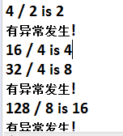
public class ExcDemo5 {
public static void main(String[] args) {
// TODO Auto-generated method stub
int numer[] = {4,8,16,32,64,128,256,512};
int denom[] = {2,0,4,4,0,8};
for(int i = 0; i < numer.length; i++) {
try {
System.out.println(numer[i] + " / " +
denom[i] + " is " +
numer[i] / denom[i]);
}
catch(Exception e) {
System.out.println("有异常发生!");
}
}
}
}

Slide 20
Try Blocks Can Be Nested
One try block can be nested within another. An exception generated within the inner try block that is not caught by a catch associated with that try is propagated to the outer try block.

